Slide 1


GEETU KANOUJIA DATA ANALYSTS
Capstone Project
Marketing Analytics

Slide 2
MARKETING ANALYTICS
Marketing analytics is method and set of technologies that help in understanding, managing and analyzing the raw data into meaningful insight to gain profit and maximize return on investment.
Our dataset is Marketing Analytics | Kaggle which is Related to a company’s sale of different products and product campaign whose Author is Jack Daoud who is the Specialist in Data Integration at Elevation Education, Boston, US.
Our dataset has total 2240 observation and 28 variables. This dataset give information about the spending of customer on different products, their personal information, their purchasing behavior and complaints of eight different countries. It also provide information about different campaign arranged by company and customer acceptance about theses campaign.
We have 24 numerical and four categorical variable. Data is about a company data that mainly want to know about how impactful their marketing strategies were? what is the response of different types of customers regarding these strategies? were they engaged or not? What type of purchasing they prefer? And so on. Table in the following slide shed light on dataset--

Slide 3
Column Name | Explanation | Column Name | Explanation | Column Name | Explanation | Column Name | Explanation
Id | It represent customers unique id | dtEnrolled | Date of customer's enrolment | amtGold | Amount spent on gold in the last 2 years | campaignAcpt2 | 1 if customer accepted the offer in the 2nd campaign, 0 otherwise
birth Year | Customer's birth year | lastPurchase | Number of days since customer's last purchase | noDealsPurchases | Number of purchases made with a discount | campaignAcpt3 | 1 if customer accepted the offer in the 3rd campaign, 0 otherwise
educationLevel | Customer's education level | amtWines | Amount spent on wine in the last 2 years | noWebPurchases | Number of purchases made through the company's web site | campaignAcpt4 | 1 if customer accepted the offer in the 4th campaign, 0 otherwise
maritalStatus | Customer's marital status | amtFruits | Amount spent on fruits in the last 2 years | noCatalogPurchases | Number of purchases made using a catalogue | campaignAcpt5 | 1 if customer accepted the offer in the 5th campaign, 0 otherwise
householdIncome | Customer's yearly household income | amtMeats | Amount spent on meat in the last 2 years | noStorePurchases | Number of purchases made directly in stores | offerAccepted | 1 if customer accepted the offer in the latest campaign, 0 otherwise
noOfKids | Number of children Of household | amtFish | Amount spent on fish in the last 2 years | noWebVisitsMonth | Number of visits to company's web site in the last month | complaint | 1 if customer complained in the last 2 years, 0 otherwise
noOfTeens | Number of teenagers Of household | amtSweet | Amount spent on sweets in the last 2 years | campaignAcpt1 | 1 if customer accepted the offer in the 1st campaign, 0 otherwise | country | Customer's location
.

Slide 4
About employed techniques and literature review
Marketing analytics is the very first step of most economical process. Philip Kotler (1994) define the marketing analytics as “function that links the consumer, customer, and public to the marketer through information-information used to identify and define marketing opportunities and problems; to generate, refine, and evaluate marketing actions; to monitor marketing performance; and to improve understanding of the marketing process.
Strong marketing techniques are often play an important role in the success and failure of a company. So, it become a necessity for every company to analyse past data to know about their behaviour, relationship with company and other important information. To fetch the information about customer preference, customer responses, customer purchases chain etc some descriptive and predictive data analytics techniques are involved.
Descriptive analytics techniques include corelation, variance, summary and clustering and predictive analytics include logistic model, KNN model, Decision tree and random forest. . Linear regression is used to predict the continuous dependent variable using a given set of independent variables. Logistic Regression is used to predict the categorical dependent variable using a given set of independent variables. KNN, Decision trees are all supervised learning algorithms Their general goal is to make accurate predictions about unknown data after being trained on known data. Descriptive analytics techniques are used to fetch some meaningful pattern from data that can help in further analysis.

Slide 5
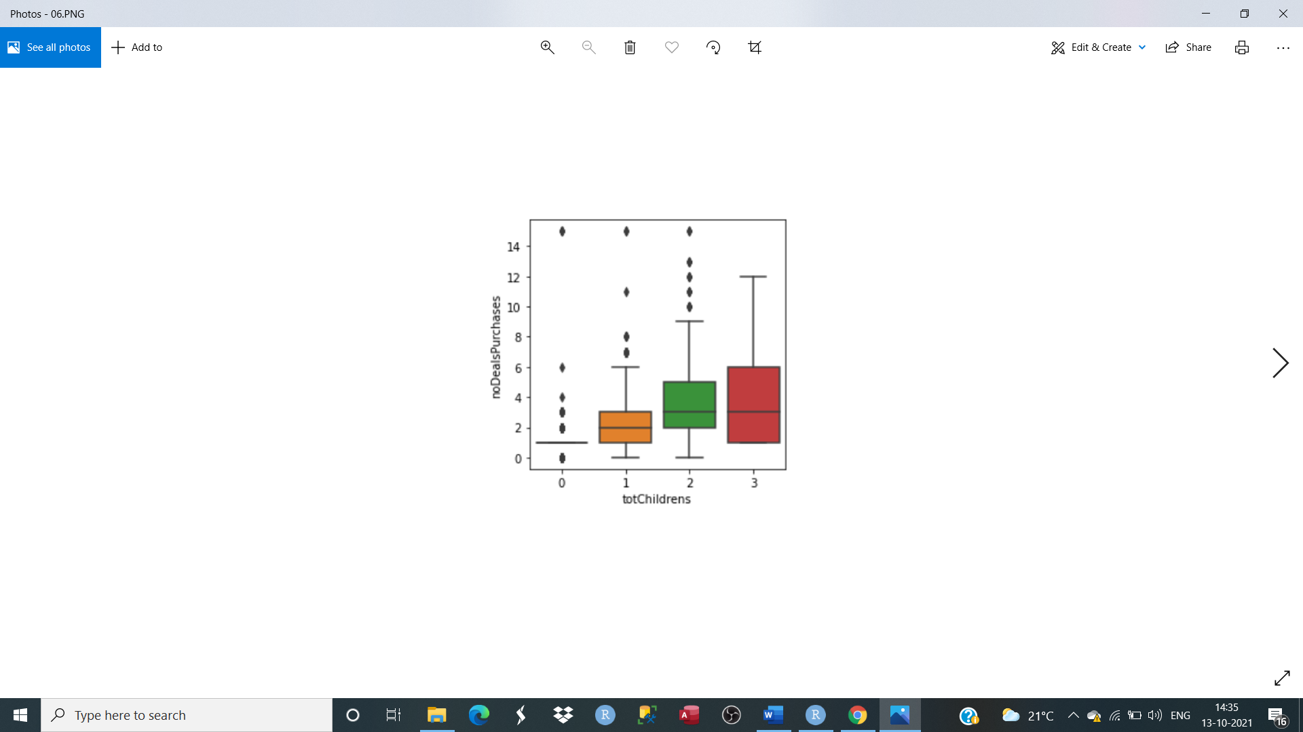
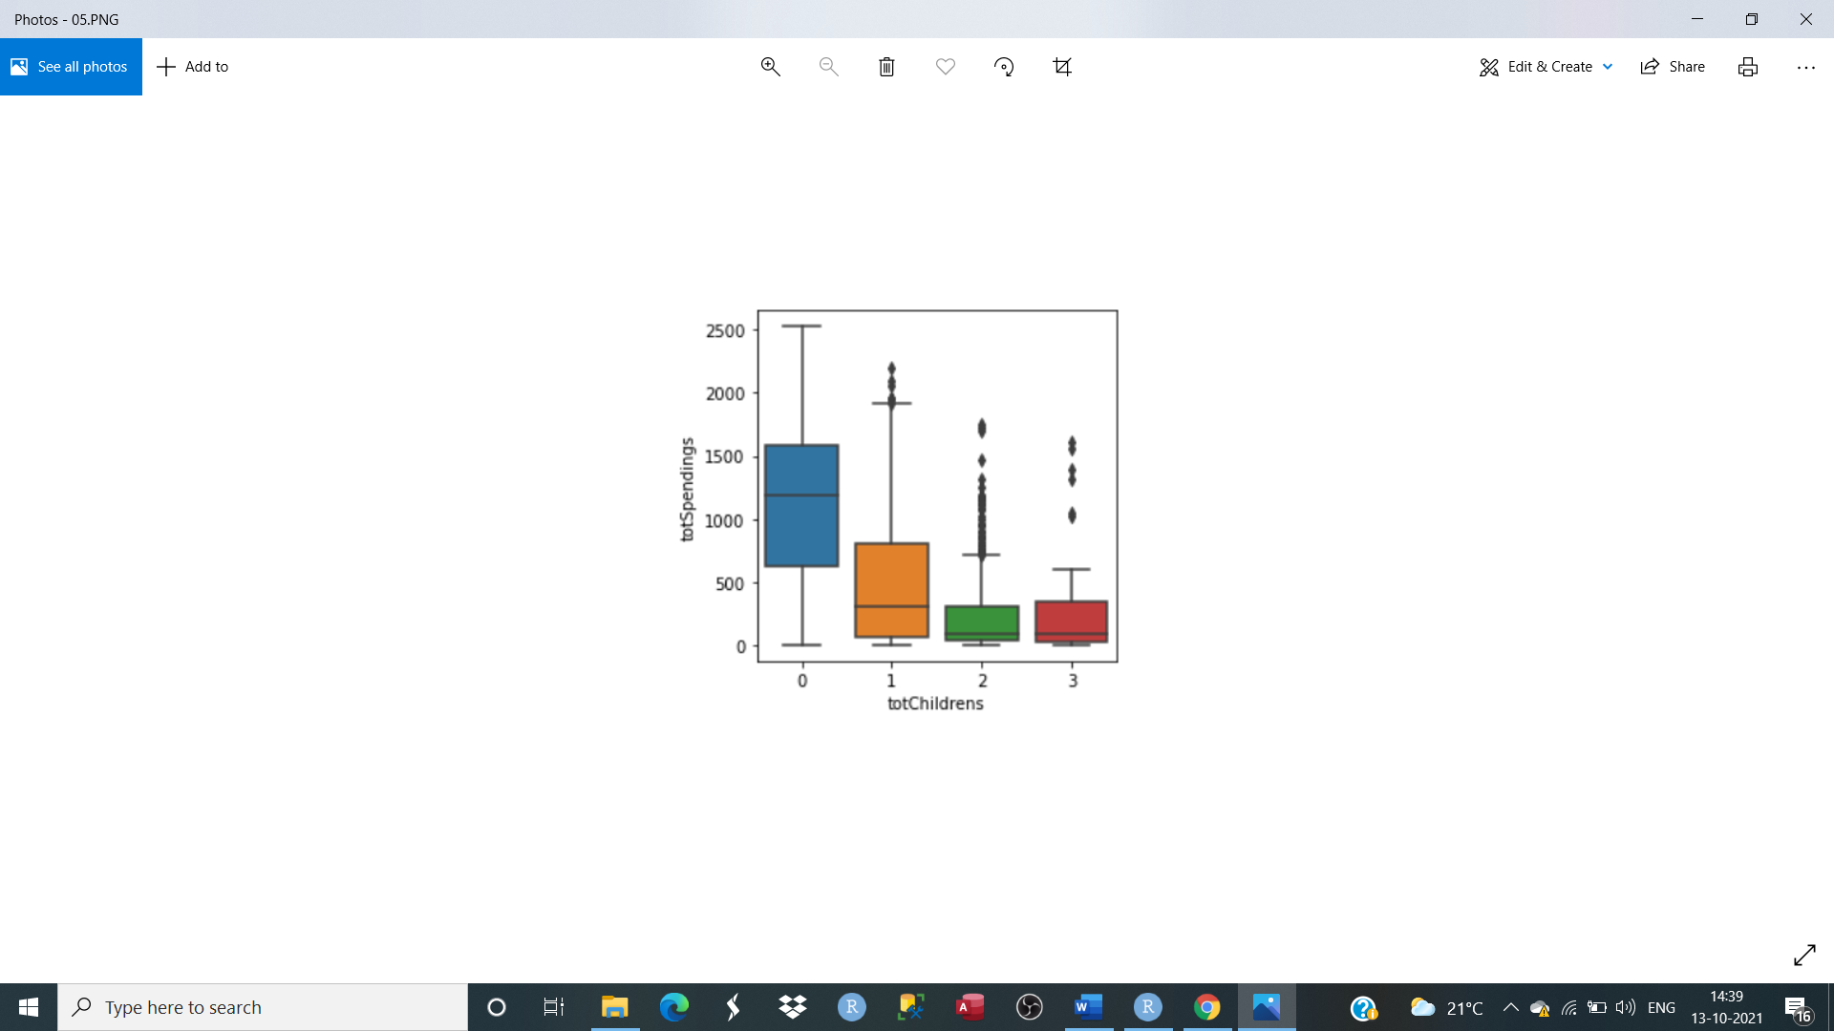
Research Questions
Q-1 How household number of children effect the spending of household?
-- As the number of children were increasing, it seems that people were becoming more and more aware about deal purchasing and deal purchases were increasing and as a result total spending was going downward.

Slide 6
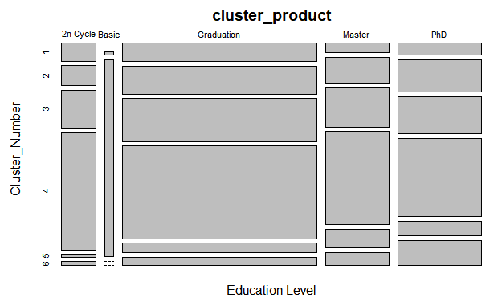
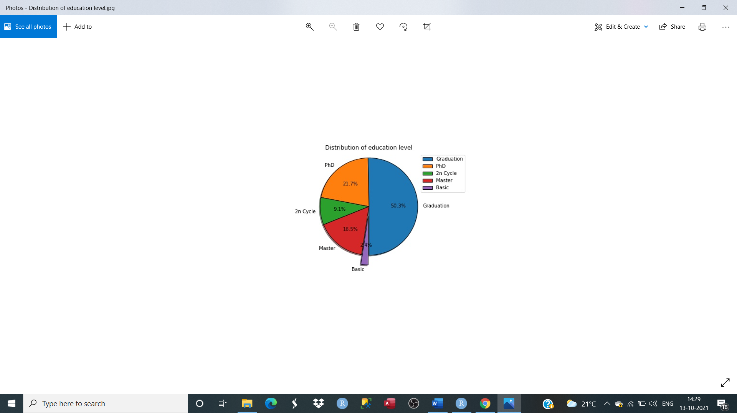
Q-2 According to education level which type of customers spent more on different products?
--- By education level, As we can see graduated (50.3%) people spent more on every product as compared to other people and people with came at second place with total 16.5% spending. Basic people came at last with only 2.4% spending.

Slide 7
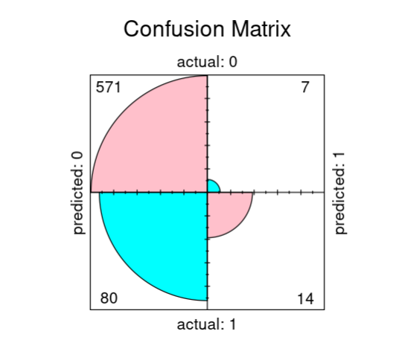
Q-3 What is the response of customers regarding different campaigns?
--- A marketing campaign is a marketing strategy for a company to promote and achieve company goals. Company arranged five different campaign for customers. Customers showed interest by accepting the offer from different campaign. Only in second and fourth campaign customers showed less interest as compared to other campaigns. We use logistic regression model to evaluate the role of different campaign to attract customers. We can say customer participated in campaign by accepting offers, so it’s a good marketing strategy.
Coefficients:
Estimate Std. Error z value Pr(>|z|)
(Intercept) -2.37185 0.09759 -24.305 < 2e-16 ***
campaignAcpt3 1.96346 0.22883 8.581 < 2e-16 ***
campaignAcpt2 1.38350 0.66953 2.066 0.0388 *
campaignAcpt4 0.61045 0.26457 2.307 0.0210 *
campaignAcpt5 1.55906 0.24428 6.382 1.74e-10 ***
campaignAcpt1 1.32739 0.25668 5.171 2.32e-07 ***
Predicted actual 0 1 0 571 7 1 80 14

Slide 8
Other Findings
Correlation matrix shows that there is no any strong relationship between variables. But it still shows the positive relationship between amount of wine and have positive corelation with number of store and catalogue purchases. And amount spent on meat have positively corelated with number of store purchases, which means most of the customers prefer to purchase meat and wine in store or by using catalogue.
From the distribution of variables, we can say that number of customers that using different purchasing type was going down, and customer still prefer in store traditional method of shopping as compared to web purchases.
preference of web visitors give information about whether the web visitors are interested in deal purchases or another web purchases and how many web user check for website only for deals every month and how many actually use deal purchases. Many web visitor come for only deals and other web purchases every month, but few of them choose web purchases and most of them come for only deals, that’s why number of web visitor per month is more for deals as compared to other simple web purchases.

Slide 9
conclusion
Marketing analytics plays an important role to improve return on investment through new marketing strategies and theses strategies are always based on analysis. This project gives an overview of the goals, metrics and best practices for marketing analytics, that can help marketing team work more efficiently and make a bigger impact. In this project we simply put light on descriptive and predictive data analysis techniques that help us to understand our data better and help to fetch some meaningful pattern from data This project shed light on descriptive and predictive analytics to measure the company’s performance, customer relationship and customer response regarding their marketing techniques like campaign. It also contain four different model to evaluate same data and compare the accuracy for best fit model. our target variable is binary and genialized linear model is our best fit model.

Slide 10


Thank you

